Slide 1

www.egida-project.eu
EGIDA PROJECT
Coordinating Earth and environmental cross-disciplinary projects to promote GEOSS
Stefano Nativi
24 Apr 2012
Vienna, Austria

Slide 2

EGIDA project
Proposal full title | Coordinating Earth and Environmental cross-disciplinary projects to promote GEOSS
Proposal acronym | EGIDA
Type of funding scheme | Co-ordination and support actions (Coordinating)
Work programme topics addressed | Area 6.4.1.1 Integration of European activities within GEO ENV.2010.4.1.1-1 Supporting the integration of European and international R&D programmes in GEO
Start date | 01 September 2010
End date | 01 September 2012

Slide 3


EGIDA GOAL
SUPPORT BROADER IMPLEMENTATION
AND EFFECTIVENESS OF THE
GEOSS SCIENCE AND TECHNOLOGY ROADMAP
AND
THE MISSION OF GEOSS THROUGH
COHERENT AND INTEROPERABLE
NETWORKING OF NATIONAL AND INTERNATIONAL INITIATIVES AND
EUROPEAN PROJECTS

Slide 4






EGIDA APPROACH
Promote
GEO in S&T Communities
Engage S&T Communities in Developing GEOSS
GEO
S&T (CB) Tasks
WP2
WP3
WP4 EGIDA Methodology & Use cases
SoS engineering process /
Lower Entry Barriers
WP5 Dissemination & Outreach
Exploitation
EU Programs
National Initiatives

Slide 5
EGIDA Approach
Bottom-up and Top-down approach
Engage
Promote

Slide 6





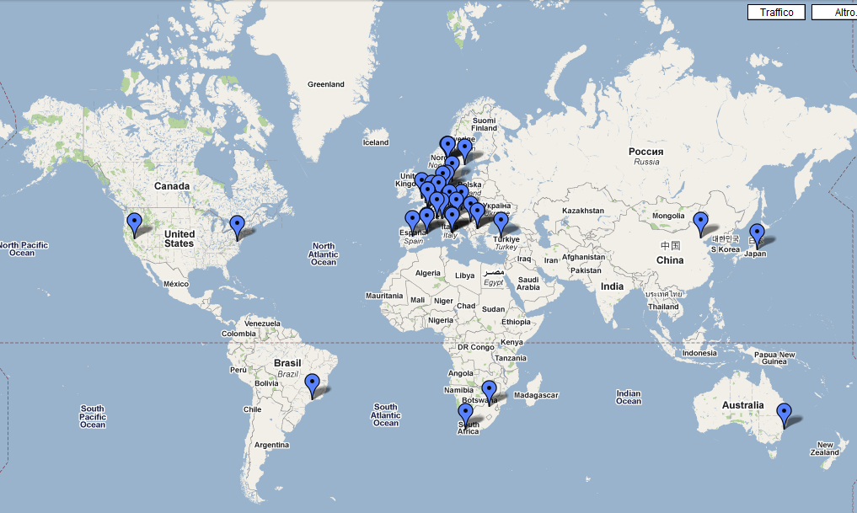
EGIDA Stakeholders

Slide 7
EGIDA Contribution to the S&T roadmap
TOP-DOWN
Assess the requirements for continuity and long-term monitoring
  Methodology and process for the evaluation of the relevance of specific observation infrastructure
  Continuity indicator for GEOSS components
Respond to S&T needs and priorities
  Availability test report
  Framework for sustained operation

Slide 8
EGIDA Contribution to the S&T roadmap
Get GEO/GEOSS better acknowledged
  Proposal for a GEOSS citation standard
Establish a “GEO label”
  Proposal for a GEOSS label
Interface with S&T communities
  Master plan for scientific sessions focusing on the GEOSS to S&T relationship
Show GEOSS at work
  Process for the identification of examples showing GEOSS at work
Catalyze research and development resources
  Framework concept for European funding agencies

Slide 9
EGIDA Contribution to the S&T roadmap
BOTTOM-UP
Analysis of National and European Initiatives and Projects/outreach to FP7 programs
Design of the EGIDA Methodology

Slide 10
Available Products
Proposal for a GEOSS citation standard
  Interim document available at http://www.egida-project.eu/images/documents/proposalforageosscitation.pdf
Proposal for a GEO label
  Interim document available at http://www.egida-project.eu/images/documents/proposalforageolabel.pdf
Framework concept for European funding agencies
  Interim document available at http://www.egida-project.eu/images/documents/framework.pdf

Slide 11
Available Products
Analysis of initiatives relevant for the GEOSS S&T objectives
  Available at http://www.egida-project.eu/images/documents/analysis.pdf
Process for the identification of examples showing GEOSS at work
  Available at http://www.egida-project.eu/images/documents/processfortheidentificationofexamples.pdf
Master plan for scientific sessions focusing on the
GEOSS to S&T relationship
  Available at http://www.egida-project.eu/images/documents/masterplanforscientificsessionsfocusingonthegeosstostrelationship.pdf

Slide 12
The EGIDA Methodology
a general methodological approach for implementing a
(re-)engineering process of the S&T national infrastructures and systems
Content
  a set of guidelines
  Covering activities to align the on-going and planned national/regional actions with the GEOSS objectives
    Technical Activities for:
      Capacity building (System-of-Systems Engineering, lowering entry barriers,…) according to a SoS (re-)engineering process
    Networking Activities
      National/Regional S&T communities engagement
      Sustainability

Slide 13


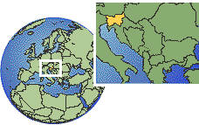
Contributions to Developing Countries
Transfer EGIDA S&T Methodology to them and implement four Specific Use Cases
  HOT SPOT POLLUTION IN THE MEDITERRANEAN
    Chemical pollution investigated under the KNOWSEAS project
  MEDITERRANIAN REGION
    Focus on partnership, infrastructures, products and
    services involving southern Mediterranean countries
  PAN-EUROPEAN “AIR QUALITY FOR HEALTH”
    Analysis of national and international stakeholders initiatives in air quality and health
    Methodology development and transfer of geo principles
    in air quality and health community
  SLOVENIA (methodology transfer in a small country use case)
    Investigate feasibility of EGIDA methodology transfer to small countries

Slide 14




EGIDA Workshops (2010-2011)
EGIDA has organized and supported workshops:
  2010 September 27-28 Rome, Italy: EGIDA Kick-off and STC Coordination
  2011 April 18-19 Rome, Italy: EGIDA/National Use Cases Workshop
    Outcomes http://www.egida-project.eu/images/documents/egida-outcomes-22-dec-2010v2-small.pdf
  2011 May 9-11 Bonn, Germany: Connecting GEOSS and its Stakeholders in Science and Technology
    Outcomes http://www.geo-tasks.org/egida/meetings/snab_ws2011/
  2011 November 17-19 Istanbul: Earth Observations for the Social Benefit of the Balkans -Post-GEO Workshop
    See http://www.postgeo-ws.itu.edu.tr/index.php?module=home
  2011 December Netherland: Planning meeting for the development of a Global Wetland Observing System (GWOS)
    Co-organized with GEO-BON

Slide 15
EGIDA Workshops (2012)
  2012, February 16, Ljubljana, Slovenia: GEO, GMES and national activities in Slovenia
    See http://www.observe-fp7.eu/index.php?option=com_content&view=article&id=160:february-12-2012-workshop-for-slovenian-stakeholders-qgeo-gmes-and-national-activities-in-sloveniaq&catid=56:news1&Itemid=242
  2012, Jan, Madrid (Spain)EuroGEOSS final workshop
    See http://www.eurogeoss2012.eu/
  2012, May 07-08, Rome, Italy: 6th GEPW
    See: http://gepw-6.teamwork.fr/
  2012, May 09, Rome, Italy: 2nd OBSERVE, BalkanGeoNet and EGIDA workshop -Capacity Building and Resources Mobilization for the Balkan region
    See http://www.egida-project.eu/

Slide 16
EGIDA Workshops (2012)
  2012, August 28—31, Bonn, Germany, 2nd GEOSS Science and Technology Stakeholder Workshop -GEOSS: Supporting Science for the Millennium Development Goals and Beyond
    See: http://www.geo-tasks.org/workshops/2012_Bonn/

Slide 17
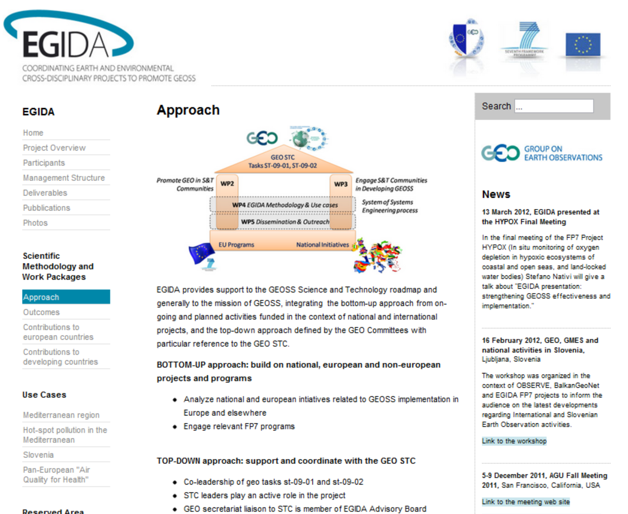
EGIDA Web site
http://www.egida-project.eu/

Slide 18
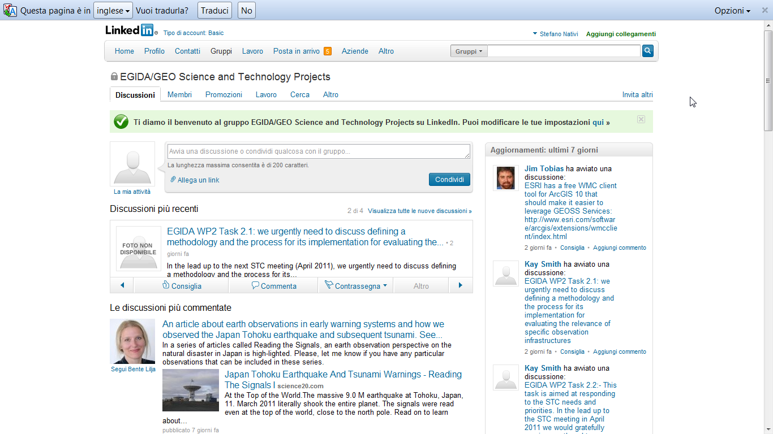
EGIDA Linked-In Group
LinkedIn Groups: EGIDA/GEO Science and Technology Projects http://www.linkedin.com/

Slide 19
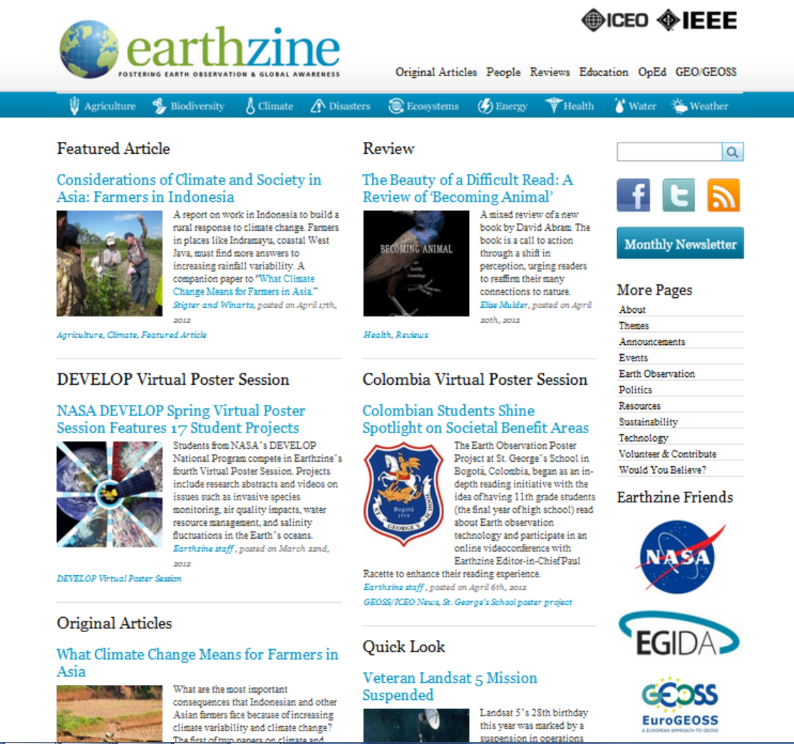
Linked to the ICEO IEEE earthzine Newsletter (friend of)
http://www.earthzine.org/

Slide 20
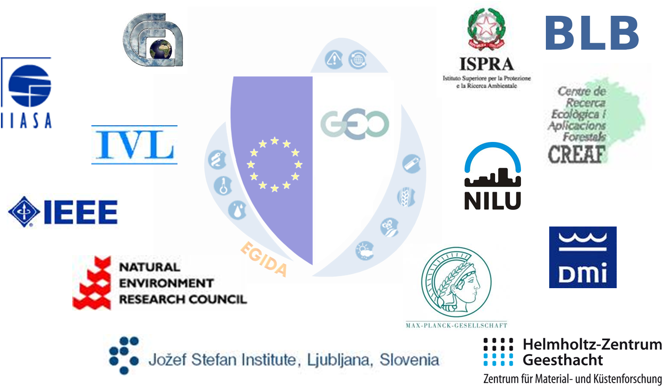
www.egida-project.eu

